Slide 1
PrEP and Porn
Trends in Popularity of Condom-less Pornographic Videos featuring Men having Sex with Men
Ken Morales
Masters Candidate
Johns Hopkins Bloomberg School of Public Health
1st Reader:
Bob Blum, MD
JHSPH, PFRH
2nd Reader:
Susan Sherman, PhD
JHSPH, HBS
3rd Reader:
John Muschelli, PhD
JHSPH, Biostatistics
Notes:
Thank y’all so much for coming and let’s get to it.

Slide 2
INTRODUCTION

Slide 3
Background
Condoms had been the standard for gay sexually explicit media (SEM) since the AIDS crisis. Unprotected anal intercourse (UAI) was regarded as kink and the domain of niche production studios.
Positive association between watching UAI and participating in the activity
2011 study: MSM whose porn consumption was > 75% UAI: OR 8.1
Advent of pre-exposure prophylaxis (PrEP) has stirred fears of “risk compensation” among MSM
2016 meta-analysis: IRR of 44.6 for MSM on PrEP acquiring syphilis vs. MSM not on PrEP
Role SEM has in sexuality education
2010 qualitative study of n = 57 young MSM: SEM was “one of the most common informal sources of sexual information”
No studies to date have examined the impact these PrEP-associated cultural and sexual shifts among MSM have had on SEM consumption.
Notes:
First, some background. In the US, condoms had been the norm gay sexually explicit media production since the AIDS crisis. This differs from heterosexual porn in the US, where condom use is rare. Anal sex between men who have sex with men without barrier protection was regarded as kink: risky sex, and generally stigmatized.
A limited number of studies have shown a positive association between watching UAI and doing UAI
The advent of a drug known as PrEP has sparked concerns for "risk compensation," a term meant to capture a substitution of sexual risk behaviors (such as not using condoms) when someone is on the drug. Risk compensation is itself coupled with stereotypes of promiscuity and associated stigma among MSM as well.
In a society such as the US where tolerance of non-normative sexualities is highly variable and where comprehensive and considerate sexuality education is virtually non existent, porn can also play a role in showing sexually naïve MSM what two men can do together.
No studies to date have examined the impact these nascent PrEP-related cultural and sexual shifts among MSM may have had on porn consumption, and that is what this study sets out to do.

Slide 4
Question
Is there a relationship between condom utilization employed in SEM featuring MSM and:
their consumers' viewing habits on the popular pornographic website PornHub (PH) in the United States in the last 10 years, and
new guidelines recommended by the Center for Disease Control (CDC) for Truvada to be used as PrEP on May 14, 2014?
Notes:
This slide I’ll read word for word:

Slide 5
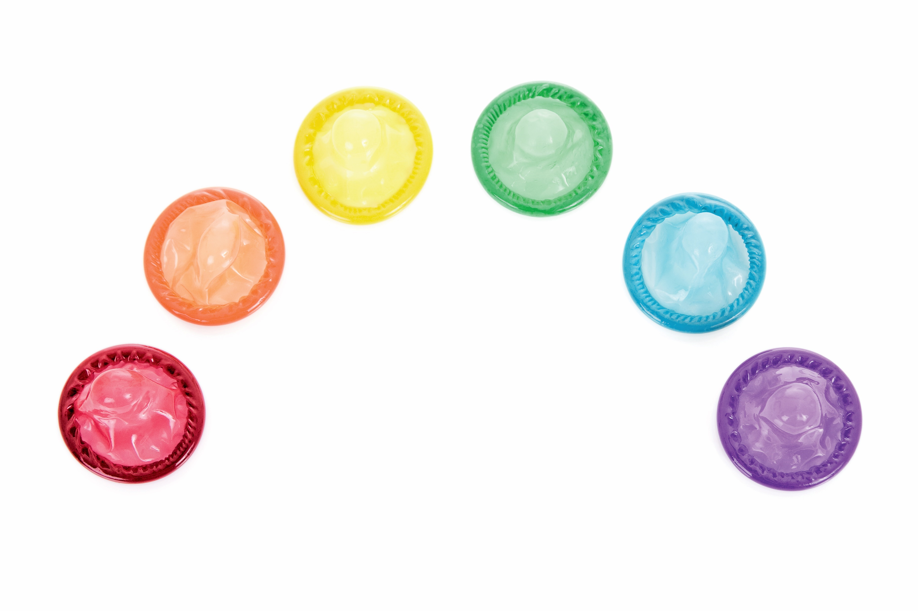

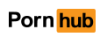
Definitions
“Barebacking“ is gay slang for UAI, and how such sex is described in the pornography industry. Most large gay pornographic studios began producing bareback porn in the years following the CDC's endorsement of Truvada as PrEP.
PrEP is shorthand for the antiretroviral drug Truvada. Truvada has had the most adoption success among MSM in the United States after recommendation by the CDC on May 14, 2014 (the “cutoff”).
PornHub is the most popular pornography site on the internet worldwide, and the 18th most popular website in the US.
Notes:
The term for UAI in gay subculture is barebacking. After the CDC’s recommendation of Truvada as PrEP, most large gay porn studios began producing bareback content.
The advent of PrEP has had cultural, social, and sexual ramifications among MSM communities concurrent to its effect on pornography production. PrEP is the preemptive use of a drug to prevent disease in unexposed populations, is almost exclusively used as shorthand for the drug Truvada, which prevents the replication of HIV in seronegative individuals.
Pornhub is the most popular porn site in the US and on the internet worldwide, and the 18th most popular website in the US overall. For context, Facebook is 3rd, Craigslist is 19th in US.

Slide 6
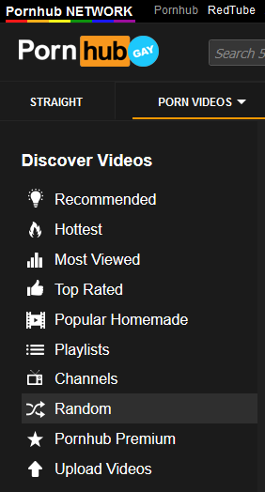

Methods
Data source: PornHub’s “random video” URL
Web scraped: 02.14.2018 – 02.25.2018
Video upload dates: 04.16.2009 – 02.13.2018
Analyses:
Time trends
Model I: linear regression to the mean
Model II: linear regression to the quantile
Notes:
I collected data on individual videos from PornHub through web scraping—an automated method of extracting textual data from websites with a bot. I scraped data in a series of small batches from February 14 - February 25, 2018, taking advantage of PH’s random video URL to capture a representative sample.
In order to be included in this cross-sectional analysis, videos had to have been present on PornHub’s servers at the time of web scraping, and be accessible through PH’s “random video” URL, be uploaded before the date of initial web scraping, be categorized as “Gay,” not be behind the PornHub Premium’s paywall.
Web scraping was performed in R using the Joint High Performance Computing Exchange (JHPCE) at JHSPH. Analyses were performed in R.
(List off analyses)

Slide 7
Measures
Dependent variable:
total views accumulated at time of web scraping divided by total time uploaded (views / year), log-transformed
Independent variables:
Dummy variable indicating upload before or after cutoff (May 14, 2014)
Upload date (decimal year format, centered and splined at cutoff)
Bareback categorization (binary)
Video rating (standardized)
Notes:
Dependent variable: total view count of the video divided by the total number of years the video was uploaded on PH, log-transformed
Independent variables:
Dummy variable for the “cutoff”: May 10, 2014 – CDC recommendation of Truvada as PrEP
Upload date in decimal years, centered and splined at the cutoff A binary variable indicating PornHub’s bareback categorization, which I relied on in order to determine if a video contains anal sex between two or more performers without use of condoms.
Video rating was controlled for in analysis: basically a percentile from 0 – 100 based on tally of website visitor votes; standardized
Data for all variables were available for the entire sample.

Slide 8
Sample
Scraped video data n = 45707
Removal of duplicates n = 27376
Removal of “solo” videos n = 24319
- 10 videos uploaded during the web scraping period
Bareback videos: n = 4951 Non-bareback videos: n = 19368
Notes:
(Review sample figure)
Mention the removal of duplicates will be addressed.

Slide 9
ANALYIS Time trends

Slide 10
Cutoff
Notes:
PornHub organizes video files by "categories" to differentiate between types of content. There are over 40 different categories. Bareback is just one of many. Note that categories are not mutually exclusive
From my sample I found the categories that amassed the most views across the entire timeline and examined them temporally. Bareback is the teal line that starts at the bottom in this grouping in 2010 and ends up on top in 2017.
For viz: data is binned by upload year, 2009 (n = 11) and 2018 (n = 220) uploads were dropped (< 1% of sample)
Cutoff is abstracted to between 2013 & 2014 due to binning: actual date is May 10, 2014

Slide 11
Cutoff
Prior to Cutoff n = 12,354 (50.8%) |  | After Cutoff n = 11,965 (49.2%) |  | Statistical Test
Not Bareback | Bareback | Not Bareback | Bareback | Pearson’s Chi 2:
n = 11,074 (89.6%) | n = 1,280 (10.4%) | n = 8,294 (69.3%) | n = 3,671 (30.7%) | p < 0.001
Notes:
While the number of videos uploaded before and after the cutoff are roughly equal (click), note the signifcant Chi 2 for the proportion of bareback videos uploaded before and after the cutoff, visually depicted in the top graph.
Same as last graphic regarding data binning and dropping 2009 and 2018. data is binned by upload year, 2009 (n = 11) and 2018 (n = 220) uploads were dropped (< 1% of sample)
Cutoff is abstracted to between 2013 & 2014 due to binning: actual date is May 10, 2014

Slide 12
ANALYSIS Model i. Linear Regression to the Mean

Slide 13
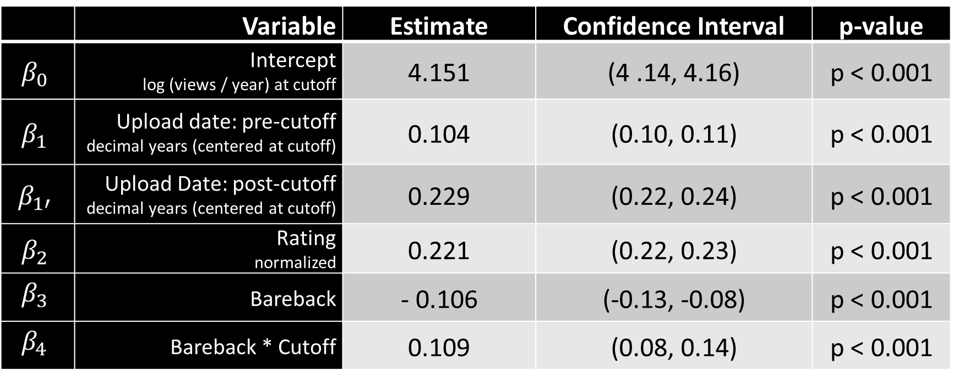
Linear Regression to the Mean Results
$$e^{\left.\log_{10}(y|x\right)}=\left\{\begin{matrix}β_{0}+β_{1}x_{1}+β_{2}x_{2}+β_{3}x_{3}+ε, & x_{1}∈\left(−∞,c\right) \\ β_{0}+β_{1′}x_{1}+β_{2}x_{2}+β_{3}x_{3}+β_{4}z∗x_{3}+ε, & x_{1}∈\left[c,∞\right)\end{matrix}\right.$$
 | Variable | Estimate | Confidence Interval | p-value
$$β_{0}$$ | Intercept log (views / year) at cutoff | 4.151 | (4 .14, 4.16) | p < 0.001
$$β_{1}$$ | Upload date: pre-cutoff decimal years (centered at cutoff) | 0.104 | (0.10, 0.11) | p < 0.001
$$β_{1′}$$ | Upload Date: post-cutoff decimal years (centered at cutoff) | 0.229 | (0.22, 0.24) | p < 0.001
$$β_{2}$$ | Rating normalized | 0.221 | (0.22, 0.23) | p < 0.001
$$β_{3}$$ | Bareback | - 0.106 | (-0.13, -0.08) | p < 0.001
$$β_{4}$$ | Bareback * Cutoff | 0.109 | (0.08, 0.14) | p < 0.001
Notes:
My model for the linear regression is presented at the top. Briefly:
The intercept is the estimate at the cutoff (CDC recommendation of Truvada)
The effect of upload date is splined at the cutoff (more recent videos have higher views)
Controlled for video rating, standardized
And the bareback variables: (CLICK)
Videos categorized as bareback, on average and regardless of when they were uploaded, have a significant reduction in the log yearly view rate
However, for bareback videos uploaded after the CDC’s recommendation (the interaction term), that reduction is compensated for, no longer suffering a penalty in log yearly views.

Slide 14
Cutoff
Notes:
The average bareback video uploaded after the cutoff, in terms of view count, is not much different from the average non-bareback video, as is graphically demonstrated in this slide. We can also see the increased proportion of bareback videos (the dark blue) as well as a distinct kink in the pattern of log yearly views that is more or less approximated by the cutoff.

Slide 15
ANALYSIS Model ii. Linear Regression to the Quantile
Notes:
However, averages mask what's going on in the “extremes” of the data.
We live in the age of algorithms and virality: popularity begets popularity – more views means more likes and more shares and even more views. The “extremes” of a measure like view count are not extreme in studies of internet media. Regressing to a different summary statistic, the quantile, is crucial to study phenomenon such as this.

Slide 16
Bareback
Zero line
Mean regression estimate
Mean regression CIs
Model Coefficient Estimate
Bareback * Cutoff
Quantile regression estimates
Quantile regression CIs
Centile of Log₁₀(Views / Year)
Notes:
Quantile regression allows us to check the adequacy of our mean regression estimates across video popularity. This graphic plots all linear regression estimates for the bareback terms in my model across centiles of video popularity.
Let’s start with the bareback coefficient at the top. Each black dot is the quantile regression model coefficient estimate for that centile. An examination of the all distinct solutions for this model demonstrates the linear regression to the mean (the solid red line) underestimates the reductive effect bareback categorization has on view count for the majority of the sample. At approximately the 80th percentile and above (CLICK), we see that this negative effect is substantially lessened, and loses significance above the 90th percentile, or the top 10% most popular videos.
The bareback and cutoff interaction term, however, is a relatively stable predictor across video popularity.

Slide 17
Linear regression to the quantile Results
Tau | (Mean) | 0.80 | 0.85 | 0.90 | 0.95
Variable | Estimate (CI), p-value significance
Intercept log (views / year) at cutoff | 4.15 (4.14, 4.16) *** | 0.46 (0.43, 0.48) *** | 4.68 (4.65, 4.71) *** | 4.85 (4.82, 4.88) *** | 5.11 (5.07, 5.14) ***
Upload date: pre-cutoff decimal years, centered | 0.10 (0.10, 0.11) *** | 0.11 (0.10, 0.12) *** | 0.12 (0.10, 0.13) *** | 0.12 (0.10, 0.13) *** | 0.13 (0.11, 0.15) ***
Upload date: post-cutoff decimal years, centered | 0.23 (0.22, 0.24) *** | 0.21 (0.20, 0.22) *** | 0.20 (0.19, 0.22) *** | 0.19 (0.18, 0.20) *** | 0.17 (0.15, 0.19) ***
Rating normalized | 0.22 (0.22, 0.23) *** | 0.25 (0.24, 0.26) *** | 0.26 (0.25, 0.27) *** | 0.26 (0.25, 0.27) *** | 0.26 (0.24, 0.27) ***
Bareback | -0.11 (-0.13, -0.08) *** | -0.09 (-0.15, -0.03) ** | -0.09 (-0.14, -0.04) *** | -0.08 (-0.15, 0.00) ns | -0.05 (-0.11, 0.02) ns
Bareback * Cutoff | 0.11 (0.08, 0.14) *** | 0.10 (0.04, 0.16) ** | 0.11 (0.05, 0.17) *** | 0.10 (0.01, 0.18) * | 0.14 (0.05, 0.23) **
PRE-CUTOFF: (01.01.2014)
Model 1:
10.1k for bareback
13.0k for non-bareback
Model 2 Q0.95:
142.1k for bareback 115.5k for non-bareback
POST-CUTOFF: (01.01.2017)
Model 1:
57.1k for bareback
57.0k for non-bareback
Model 2 Q0.95:
444.8k for bareback 361.5k for non-bareback
Notes:
What this means is that among the most popular videos, my model predicts that bareback categorization does not have a net negative effect on yearly views, but may actually provide a boon. This table compares the mean regression results to the model coefficient estimates achieved by regressing my model to the 80th, 85th, 90th, and 95th centiles.
(CLICK) As visually indicated in the previous plot, at the 90th and 95th centiles bareback categorization is not significantly associated with a reduction in log views per year, and at the 95th centile bareback categorized videos uploaded after the cutoff gain a significant boost to view counts.
(CLICK) I crunched the numbers on 4 video view counts to compare “average” videos uploaded before and after the cutoff to some of the most popular videos. In this example, the most popular bareback videos enjoy almost 30k more views / year if uploaded in 2014, and this increases to over 80k views / year if uploaded at the beginning of 2017.
This top 5% of videos by popularity (1,216 vides) account for ~ 1.26 billion individual views, or just over 40% of the total view count recorded in the entire sample.

Slide 18
DISCUSSION

Slide 19
Implications
Demonstrated rise in popularity of bareback videos has implications for public health practitioners who work with MSM or in sexually transmitted infection control
Considering the potential instructive role SEM has for young MSM, import of bareback SEM could be magnified among younger viewers
Health equity concerns pertaining to those who can and do use PrEP and those impacted by viewership of UAI in gay SEM
Averages can obfuscate the “extremes” in statistical research on media consumption
More high-quality research is needed
Notes:
While video popularity doesn’t extend directly into viewer preference or viewer actions, it is a notable shift that could be indicative of these and other phenomena. My research has implications for people who work with MSM or in STI control. Researchers and clinicians have noted an increase in sexually transmitted infections among MSM--data from a clinic in San Francisco, for example, show a steep climb in incident gonorrhea and syphilis among both HIV-positive and HIV-negative gay men, even while incident HIV cases continued to decline.
Considering the potential instructive role SEM may have for young MSM. Studies have shown that up to half of male youths had seen online porn before they turned 13.
Given the economic and social capital required to receive and maintain adherence to PrEP and the relatively low bar required to access SEM, there are significant health equity concerns pertaining to those most impacted by the viewership of unprotected anal intercourse in gay SEM.
And finally, of course, more research is needed to examine the ways non-clinical factors of gay male sociability and sexuality, including porn consumption, factor into increasing trends of bacterial STIs among MSM.

Slide 20
Limitations
No time series data on views accumulation for videos
Assumption of the sexuality and gender of viewers
Reliance on PornHub’s categorization system for “bareback”
Unable to control for web traffic by country of origin
PornHub’s “random video” URL is not so random
Notes:
The current study operates within several limitations.
In terms of temporality, the ability to know the view count growth for individual videos would have greatly refined the analysis.
I was unable to control for the identity of viewers. According to PornHub, 37% of all gay male porn views are from women (PornHub, 2017).
PornHub’s "Bareback" category may not fully capture all videos that contain penetrative sex without the use of condoms. Sensitivity analyses were beyond the scope of this project.
Isolating viewership by country of consumer was not possible, but PornHub’s published web traffic data shows that the US generates the most traffic and has the highest per capita page views.
Finally, the analysis was reliant on PornHub’s randomization scheme, which, if you recall the sampling, is either not random (n = 18,331 dropped, or over 40% of the originally scraped video metadata) OR a majority of the true video upload population. There is no way to verify that the sample pooled from this random URL is truly representative.

Slide 21

Acknowledgements
Robert Blum (JHSPH)
Susan Sherman (JHSPH)
John Muschelli (JHSPH)
Jeff Leek (JHSPH)
Eric Schrimshaw (Columbia SPH)
Steven Dashiell (UMBC)
Daniel Simpson (U of Toronto)
Ben Ackerman (JHSPH)
Stephen Cristiano (JHSPH)
Blair Berger (JHSPH)
JHPCE Staff
My PopFamily
The R Open Source Community
Coffee
Lofi Hip Hop Radio on YouTube
Haus of 910 N. Calvert
My friends
& my family
Notes:
And my boyfriend Jon.

